Slide 1
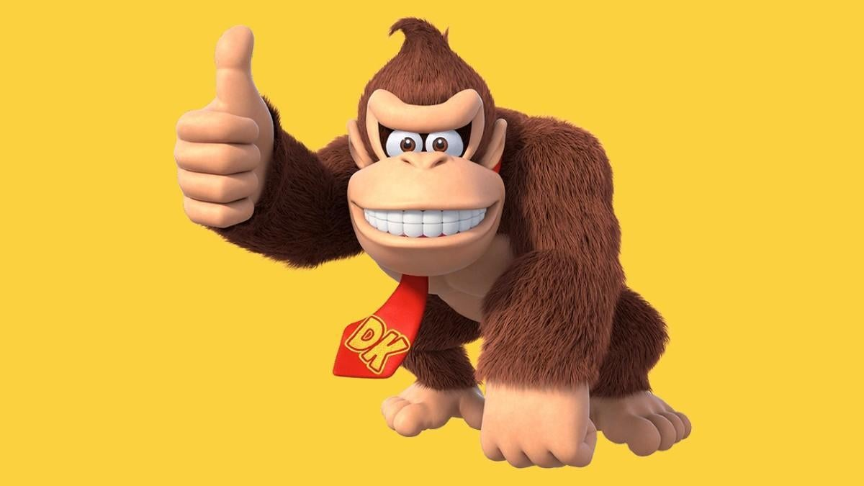
Human level performance of an AI playing Donkey Kong
Jakub Grzywaczewski, Anna Ostrowska, Igor Rudolf, Marta Szuwarska
[1]

Slide 2
Contents
Donkey Kong
Objective
Gymnasium Donkey Kong
Base algorithm
Baseline results
Modifications
Punishing needless jumping
Ladders incentive
Magic stars incentive
Level incentive
Action heuristics
Results for different combinations of modifications
Final results
Bibliography

Slide 3
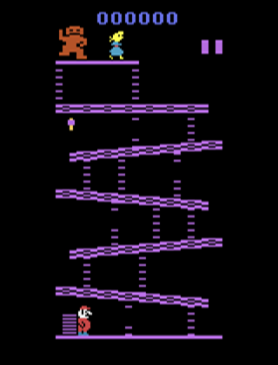
Donkey Kong
Donkey Kong is an arcade video game in which the player takes on the role of Mario and aims to rescue his girlfriend from a giant gorrilla called Donkey Kong.
In order to get to his girlfriend, Mario needs to climb the unbroken ladders and omit the barrels.
In addition, if Mario grabs the hammer, he can hit the barrels.

Slide 4
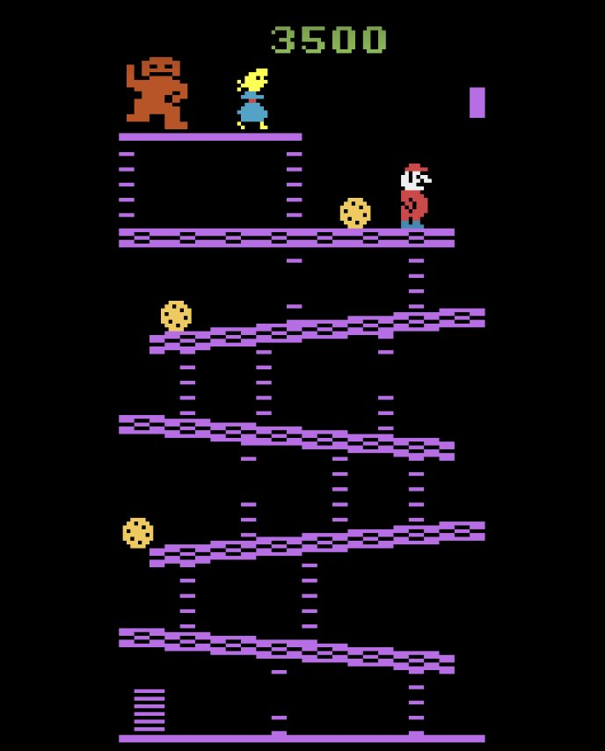
Objective
The primary objective:
Reach the first level successfully
Secondary objective:
Do it better, faster than a human

Slide 5

API

Slide 6
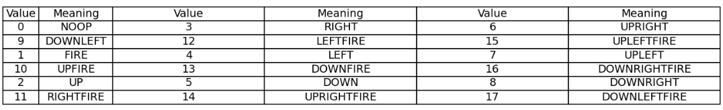
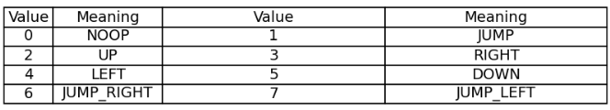
Set of Actions
Set of possible actions included in the Gymnasium and their meanings:
Set of possible actions chosen by us:

Slide 7
DQN
Deep Q-Networks (DQN): algorithm that combines Q-learning, a model-free reinforcement learning algorithm, with deep neural networks to handle high-dimensional state spaces.
Key concepts:
Q-learning
Deep Neural Networks
Experience Replay
Split Target and Value Networks

Slide 8
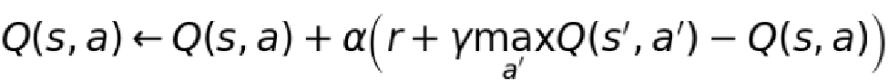
DQN explanation
Q-learning: value based algorithm. It seeks to learn a policy that maximizes the total reward by learning the action-value function Q(s,a) , which represents the expected reward of taking action in a state s. The Q-function is updated using the Bellman equation:
Deep Q-Networks (DQN): uses a neural network to approximate the Q-function. Useful when we deal with large or continuous state spaces
Experience replay: stores the agent's experiences (state, action, reward, next state) in a replay buffer and samples mini-batches of experiences to train the neural network.
Target Network: is a copy of the Q-network that is used to generate the target values during training. The target network is updated less frequently than the Q-network to improve stability.

Slide 9
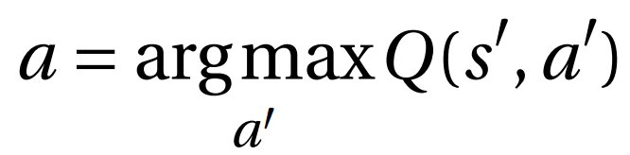
SARSA
Sarsa (State-Action-Reward-State-Action): is an on-policy reinforcement learning algorithm used to solve Markov Decision Processes (MDPs).Unlike Q-learning, which is off-policy and uses the maximum future reward to update the Q-value, SARSA uses the action taken by the current policy to update the Q-value.
Q-value update:
Epsilon-greedy policy: With probability epsilon choose random action. With probability 1-epsilon, choose the action that maximizes the Q-value.

Slide 10
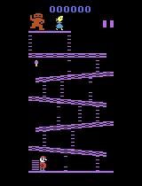
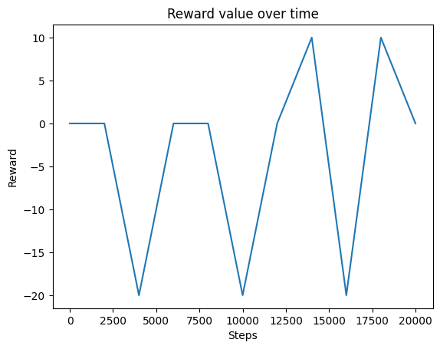
Baseline
At first, we only punished the agent for dying (PD), which resulted in the agent staying at the first level moving away from the barrels as much as he can.

Slide 11
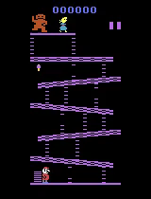
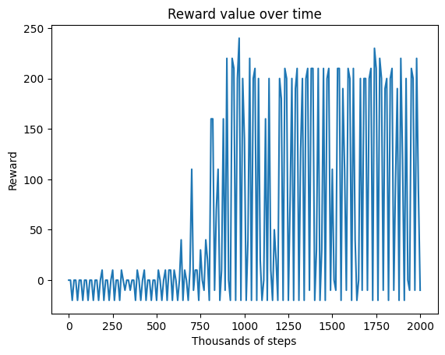
Baseline
With time the agent learned to jump over barrels.

Slide 12
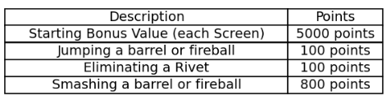
Baseline
Why does it not work?
While you control Mario, the Score/Bonus Indicator shows
your bonus counting down. Between screens and at game end, your
score is displayed.
Scoring:

Slide 13
Ideas after consulting
Severe punishment for needless jumping
Rewarding going up and punishing going down while on a ladder
Odds of specific actions dependent on the altitude level
Evaluation without exploration every n episodes
High reward for following magic stars path

Slide 14
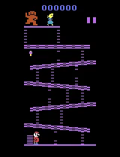
Punishing needless jumping (PNJ)
We added a function that checks if there is any barrel near Mario.
Every time Mario was not near the barrel or on the ladder and jumped up, we gave him a negative reward.

Slide 15
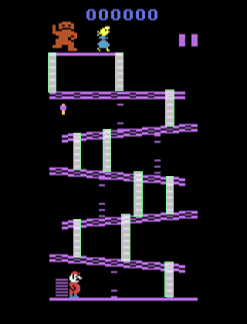
Ladders incentive (LAD)
We found pixels corrensponding to ladders manually and then tested whether they actually coincide with the field where Mario can go up.
Then we modified the punishment for needless jumping so that Mario is not punished if close to the ladder.
We also added a reward for moving up on a ladder.

Slide 16
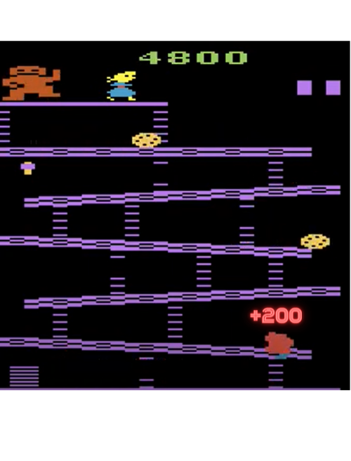
Level incentive (LVL)
We added a reward for climbing to the next altitude level.

Slide 17

Magic stars incentive (MS)
We chose the path Mario would have to take to get to the princess and placed some points (“stars”) on it.
The moment Mario reached the area of the star, we gave him a reward for it and removed the star from the available to get in a given game.

Slide 18
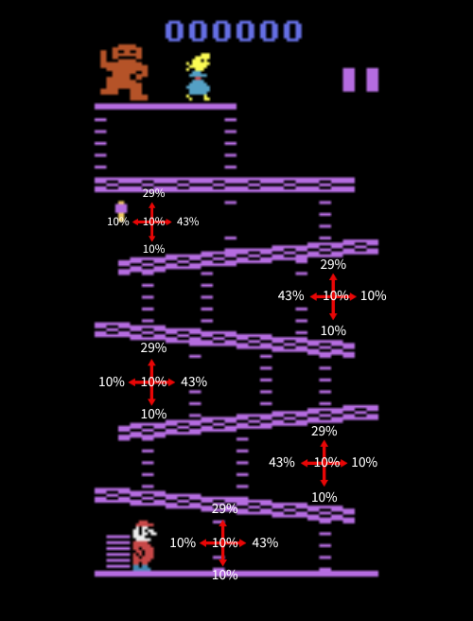
Action heuristics (AH)
We wanted to take control over actions performed by Mario. One way of doing this was to create discreate distribution depending on Mario's current level.

Slide 19

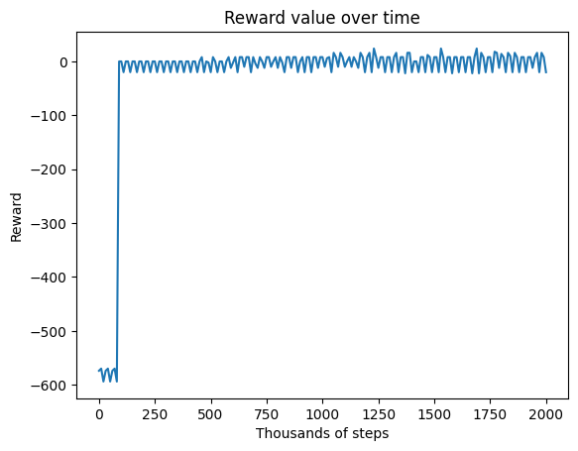
Punishing needless jumping
Adding punishing needless jumping only resulted in the agent going back and forth.

Slide 20
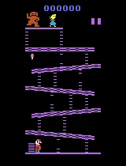
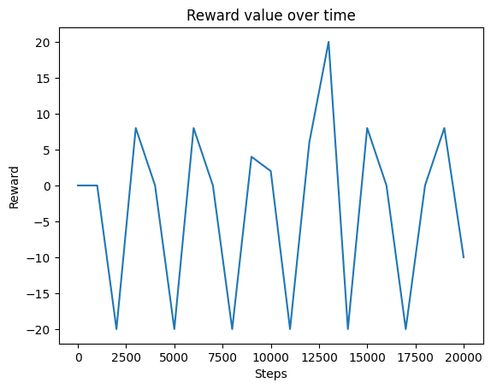
Magic stars incentive
Adding magic stars incentive only resulted in the agent walking in circles.

Slide 21
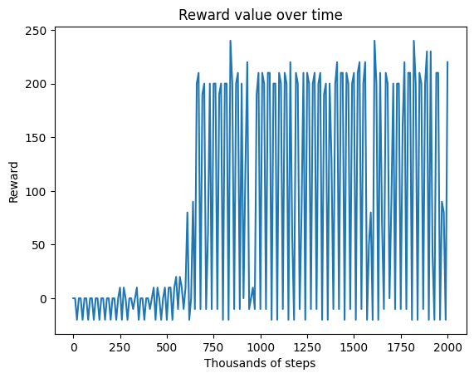
Level incentive
Adding level incentive only resulted in needless jumping.

Slide 22

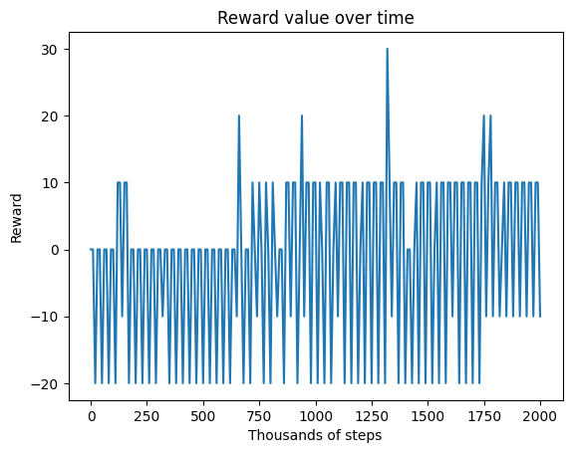
Action heuristics
Adding action heuristics only resulted in agent doing random things.

Slide 23
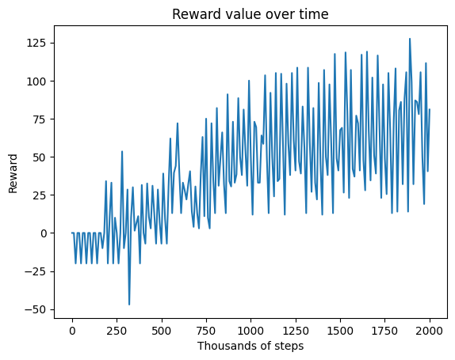
LAD + LVL
Combining ladders and level incentives resulted in the agent actually climbing to the fifth level.

Slide 24
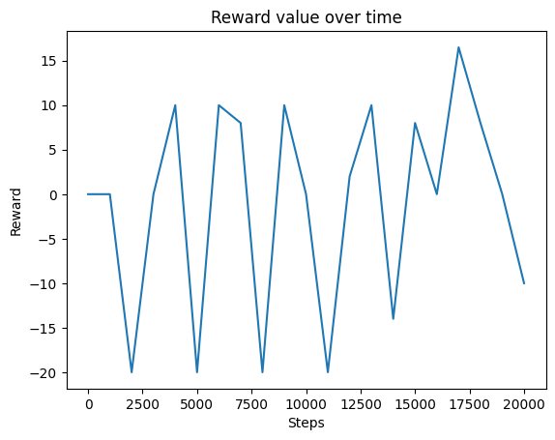
LAD + LVL + MS
Combining all the incentives resulted in the agent going only right or standing/jumping without changing place.

Slide 25

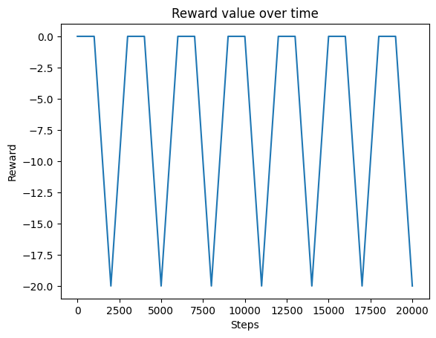
NJ + AH
Adding the combination of punishing needless jumping and action heuristics resulted in the agent going in circles or standing still.

Slide 26
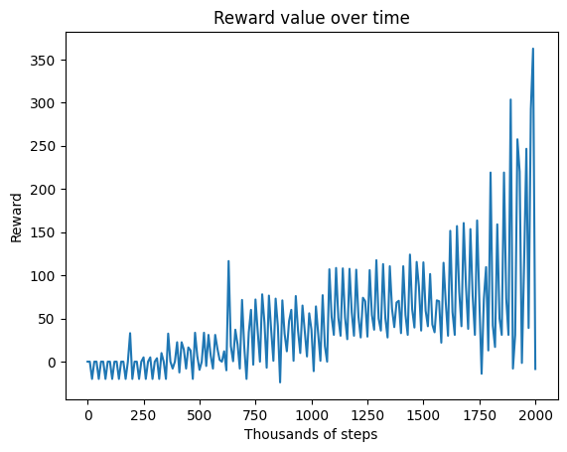
LAD + LVL+ PNJ
Combining ladders and level incentive with punishing needles jumping resulted in the agent finally climbing almost all the way up and getting the hammer.

Slide 27
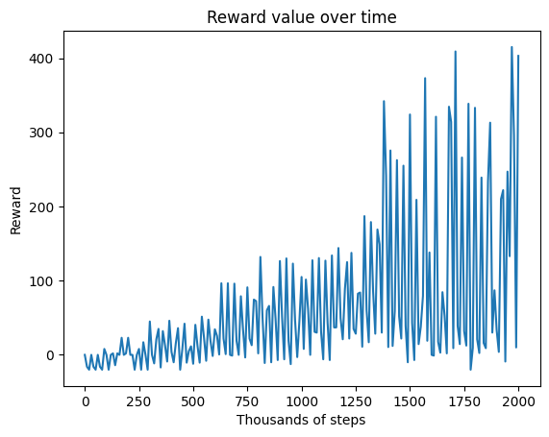
LAD + LVL + MS + PNJ
Combining all incentives with punishing needles jumping gave similar results.

Slide 28

Final results
Total steps: 2M
Gamma: 0.99
Linear schedule with epsilon going from 1 to 0.04 at 30% of steps
Modifications:
LAD + LVL + MS + PD + PNJ + AH
Training time: 12h

Slide 29
Bibliography
[1] https://sportshub.cbsistatic.com/i/2023/09/26/b4f08ca9-d46d-40db-affe-6940c10aa551/donkey-kong.jpg
[2] https://gymnasium.farama.org/environments/atari/donkey_kong/
[3] https://gymnasium.farama.org/
[4] https://github.com/DLR-RM/stable-baselines3
[5] https://atariage.com/manual_html_page.php?SoftwareLabelID=149
[6] https://github.com/torch/torch7/blob/master/README.md
[7] https://opencv.org/

Slide 30
Thank you
GitHub repository:
https://github.com/OptimalAgents/RL-DonkeyKong

